Slide 1


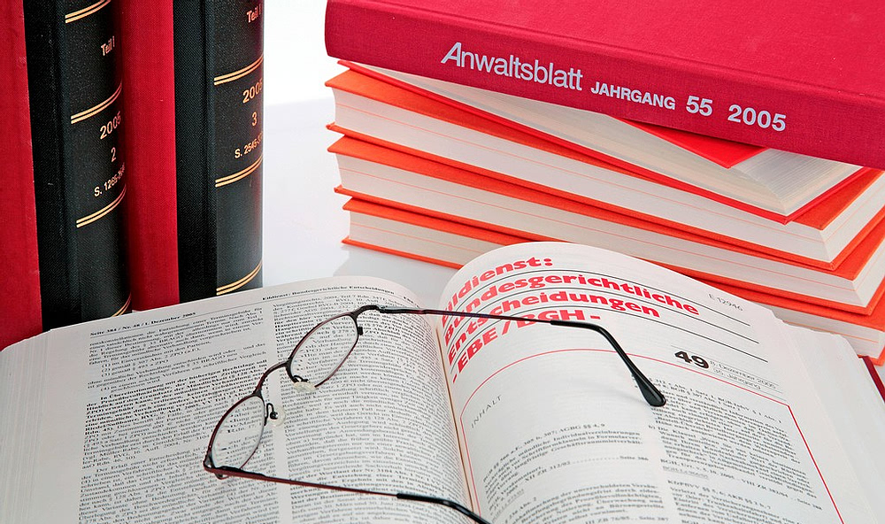
Our Practice, is your solution

Slide 2
About Us
Our Practice, is your solution

Slide 3
Who we are
C.N. KARANJA & ASSOCIATES ADVOCATES is an established law firm undertaking legal work for our clients with utmost professionalism, due care, integrity and in a value optimizing way. Legal advice is the application of abstract principles of law to concrete facts of the client’s case in order to advise the client about what to do next. Thus, since inception the management has spent considerable time and resources setting up systems, procedures and the adoption of strategies aimed at enhancing legal service to our clients under the written Laws and the specified provisions thereof. We endeavour to ensure that you get justice and solve your legal matters. Indeed, every client of C.N. Karanja & Associates Advocates is handled with ultimate care and respect.

Slide 4




Professional Memberships
Law Society of Kenya

Slide 5
Our MISSION
To provide high quality legal services to our clients without compromising on legal ethics.

Slide 6
Our Philosophies
Our firm embodies the three tenets of justice – the client, the court and the legal team. We assist our client to get justice, which they are entitled to through delivery of quality service. We recognise that to serve our clients and fully meet their expectations, we must invest time and effort to understand them, their business, their short and long-term goals and the internal and external environment that they operate in.
To achieve this objective we are committed to a strong client-centred relationship based on extensive partner-client interaction through direct partner involvement in service delivery to the client.
Ours is a credible firm whose performance is exemplary, handling all cases with objectivity, ethics and respect for confidentiality.

Slide 7
Our Strategic Theme
At C.N. Karanja & Associates Advocates we are committed to building a reputable law
firm, a leader in providing customer friendly and quality legal services. We strive to :
  Provide accessible, dependable and timely services to our clients.
  Be fair and respectful in the course of performing our duties.
  Be clear and transparent in our operations.
  Be responsive to the needs of our clients and be committed to improvement in legal service delivery.
In this regard we have undertaken the following steps:
  Consistently develop and retain a professional workforce.
  Developed and implemented performance based appraisal system.
  Implemented objectively feasible performance parameters.
  Established clear communications channels among the staff, clients, and other stakeholders.

Slide 8
Areas of Expertise
Our strengths in the legal profession lie in the areas of:
Corporate, Commercial, Business & Company Law
Bankruptcy and Receivership Law
Conveyance and Land Law
Real Estate & Property Law
Banking and Financial Law
Intellectual Property
Landlords & Tenants, Leases & Rent Tribunal Matters
Trust and Succession Law
Arbitration & Other Alternative Dispute Resolution Matters
Legal Training

Slide 9
Other Areas
Notaries Public
Commissioners for Oath
Certified Public Secretarial Services

Slide 10
OUR CLIENTS

Slide 11




Our Bankers

Slide 12
Corporate Clients
Catesam Enterprises Limited
Co-operative bank of Kenya
Kingdom Bank
Family Bank Limited
Suera Flowers Limited
Jese Holdings Limited
Karen Holiday Homes
Muruga Investments Limited
Ciata Holdings Limited
Clarence House Apartments Limited
Heathway Properties Limited
Miliki Development Company Limited
Richland Dam Estate
Ngoingwa Company Limited

Slide 13



Faith-Based Organizations (FBOs)
Kenya Episcopal Conference (Catholic)
Association of Member Episcopal Conferences of Eastern Africa (AMECEA- Catholic)
Koinoina Community

Slide 14
Assurance of Quality Service
In line with the firm’s mission of providing high quality services that guarantee value for money, we have established a Client Services Supervision (CSS) department that is responsible for maintaining close liaisons with the clients. The department deals with clients complaints on service delivery or quality and attends to service request from clients.
The firm has a well-stocked legal library to assist partners and professional legal staff in the performance of their work.

Slide 15
Confidentiality Pledge
We promise to…
Keep strictly confidential all information given by our clients
Use information for the purpose of carrying out clients work.
Keep strictly confidential all workings and results derived from the clients work.

Slide 16

Professional Indemnity
C.N. Karanja & Associates Advocates has a current professional indemnity cover with Heritage Insurance Company Limited.

Slide 17
Future Outlook
The firm has strategically placed itself for the challenges of the future resulting from a liberalised and globalised working environment. The firm is in the process of establishing links with international legal firms and financial advisors particularly those specialising in offshore financing, insurance and re-insurance.

Slide 18
Our Organizational Framework
The organisational framework of the firm reflects the activities that it undertakes within its mandates and style of management adopted for effective service delivery. The firm consists of a team of talented highly experienced lawyers relying and respecting each other’s skills and work ethics to service clients accounts diligently with integrity and honesty.
The principal partners are highly experienced advocates with over 60 years of combined legal experience.

Slide 19
Our People

Slide 20
Catherine N. Karanja (Mrs)
Mrs. Catherine Nyambura Karanja is the Senior Partner and has over 25 years experience in land registration matters. She has a wide range of experience in conveyance, land law, company law and property legal work.
She was a legal pupil at the firm of Hamilton Harrison & Mathews Advocates and thereafter held a Holding over position for 1 year.
Catherine has previously been in the Public Civil Service where she worked for the Government of Kenya in the Ministry of Lands and Settlement for 16 years from 1991 to 2007.
She holds an International Diploma in Land Information Systems from Swedesurvey Sweden.
She held many positions as a Registrar of Titles/Land Registrar in various sections of the Department of Lands where she dealt with Registration of Land Titles, Grants, Title Deeds, Charges, Leases, Mortgages and all types of documents registered under the numerous Land Acts. She rose to the position of Senior Registrar of Titles in the Department of Lands.

Slide 21
Catherine Karanja ( Mrs.)
Has a wide experience on the operation of the numerous Land Acts namely:- The New Land Acts now being; Land Registration act No. 3 of 2012; the Land Act No. 6 of 2012; and the Repealed Acts namely: RLA Cap 300 Registered Land Act (Now Repealed), GLA Cap 280 Government Lands Act (Now Repealed), RTA Cap 281 Registration of Titles Act Land Titles Act (LTA) Cap 282 (now Repealed), Sectional Properties Act, Stamp Duty Act, Land Adjudication Act, The Land Control Act Cap 302, The Trustees (Perpetual Succession) Act (Cap164),The Registration of Documents Act (Cap 285),The Land Disputes Tribunal (Act No. 18 of 1990). She has been a Collector of Stamp Duty and has wide experience in assessment of stamp duty in all legal documents that attract stamp duty. She has also undertaken duties as an Estate Manager in the Adjudication and Settlement Department in the Ministry of Lands & Settlement where she was charged with duties of preparing Discharge of Charge Documents, transfer of land and charges for settlers under the settlement schemes on behalf of the Settlement Fund Trustees. She also held the position of Senior Legal Officer – Settlement Fund Trustees.
Before forming C.N. Karanja & Associates Advocates, she was the Managing Partner at Kagwe Kamau & Karanja Advocates for over 10 years.
Catherine holds an LLB (Hons) Degree from the University of Nairobi, Diploma in Advocacy from Kenya School of Law (KSL) and an International Diploma in Land Information Systems from Sweden.

Slide 22
Associates
Mr. MARVIN MUCHERU MWIRIKIA:
He is an associate in the firm with 1 year Post-Admission experience in legal practice. He has wide experience in, Conveyance, Civil Litigation, Probate & Succession Law, Debt Collection, Commercial Law, Company law, Intellectual Property Law and Employment Labour Law.
  He was a legal pupil in this firm for 1 year and also held a holding over position for 2 years.
Marvin holds LLB. (Hons) from Mount Kenya University (MKU) and a Diploma in Advocacy from the Kenya School of Law (KSL) .

Slide 23
Staff
Mary Veronica Wanjiku: She is a Legal secretary/Office Administration Manager. Before Joining C.N. Karanja & Associates Advocates, She worked as a Legal Executive secretary at the Principal Registrar of Titles/Chief Land Registrar in the Ministry of Lands and Settlement, Kagwe & Company Advocates and Kagwe Kamau & Karanja Advocates. She is the executive legal secretary with a wide experience in Conveyance and Land matters of over 30 years.
Ann Wanjiku: Ann is a Legal Secretary/Administration Assistant in Litigation, Commercial Department. She worked as a secretary in various firms giving her a wide range of experience in handling different types of jobs. Before joining C.N. Karanja & Associates Advocates she worked for Kagwe, Kamau & Karanja Advocates, Kithimba Associates, a Consulting Engineers Firm, Nyakio General Constructors, a civil engineering firm and Sheth and Wathigo Advocates. She is a trained secretary and is computer literate.
Lawrence Mungai: He is the Firm’s Accountant. He has a wide experience in accounting and auditing. Before joining C.N. Karanja & Associates Advocates he worked for Bata Shoe Company as an Accounts Clerk, and for Kagwe Kamau & Karanja Advocates as an Accountant/Conveyancing Clerk, giving him a wide experience in his work.
Sarah Muigai: Sarah is an office assistant. Before joining C.N. Karanja & Associates Advocates, she worked for Segani Home Cleaning Services and Kagwe, Kamau & Karanja Advocates.

Slide 24
Western Heights, 2nd floor, Suite 11
Karuna Road, Next to Sarit Centre
Westlands
P.O. Box 2318-00606
NAIROBI
Tel: 0727770668, 0729651125
Email: wakili@cnklaw.co.ke
THANK YOU

